Slide 1
A Gentle Tutorial of the EM Algorithm and its Application to Parameter
Estimation for Gaussian Mixture and Hidden Markov Models

Slide 2
Abstract
We then develop the EM parameter estimation procedure for two applications:
  Finding the parameters of a mixture of Gaussian densities.
  Finding the parameters of a hidden Markov model(HMM) for both discrete and Gaussian mixture observation models.
Emphasize intuition rather than mathematical rigor.

Slide 3

1.Maximum-likelihood
We have a density function p(x|Ө),that is governed by the set of parameters Ө (e.g. p might be a set of Gaussians and Ө could be the means and covariances).
X={x₁,…x_{N}} is a data set of size N.Assume that these data vectors are independent and identically (i.i.d) with distribution p.

Slide 4

1.Maximum-likelihood(cont.)
L(Ө|X) is called the likelihood function.(just the symbol)
We want to maximize L(Ө|X) and find Ө* such that L(Ө*|X) is maximum.

Slide 5
1.Maximum-likelihood(cont.)
Often,we maximize log(L(Ө|X)) instead because it is annlytically easier.
For Example,if p(x|Ө) is simply a single Gaussian distribution where Ө=(μ,σ²),then we can set the derivative of log(L(Ө|X)) to zero,and solve directly for μ and σ² [see textbook p.105]

Slide 6
2.Basic EM
There are two main applications of the EM Algorithm:
  The data indeed has missing values,due to problems with or limitations of the observation process.
  When optimzing the likelihood function is analytically intractable but when the likelihood function can be simplified by assuming the existence of and values for additional but missing parameters.

Slide 7

2.Basic EM(cont.)
We assume that data X is observed and is generated by some distribution.
We call X the incomplete data.
We assume that a complete data set exists Z=(X,Y).
And assume a joint density function:

Slide 8
2.Basic EM(cont.)
So,we can define a new likelihood function L(Ө|Z)= L(Ө|X,Y)= p(X,Y|Ө), called the complete-data likelihood.
Since Y is unknown , random , we can presume Y is governed by a distribution.And so,the function L(Ө|Z) is in fact a random variable.That is,we can think of L(Ө|X,Y)=h_{x,Ө}(Y) where X and Ө are constant and Y is a random variable.

Slide 9

2.Basic EM E-step
The first step of EM Algorithm (E-step) is to find the expected value of the complete-data log-likelihood log(p(X,Y|Ө)) with respect to the unknown data Y given the observed data X and the current parameter estimates Ө^{(i-1)}.Here we let Ө be the new parameters.

Slide 10

2.Basic EM E-step(cont.)
Then,we define a function - Q function. Q(Ө,Ө^{(i-1)}) to represent the above expectation expression.
Note that X and Ө^{(i-1)} are constants,Ө is a normal variable that we wish to adjust,and Y is a random variable.

Slide 11
2.Basic EM E-step(cont.)
Q – function can be re-written as:
Note1:
Note2: Y is governed by the distribution
In other word,
is the marginal distribution of Y and is dependent on both X and Ө^{(i-1)}.

Slide 12
2.Basic EM E-step(cont.)
Sometimes,in fact,the density actually used is
this doesn’t effect subsequent steps since the extra factor is not dependent on Ө.

Slide 13

2.Basic EM M-step
The second step of EM Algorithm (M-step) is to maximize the likelihood.
E-step and M-step are repeated as necessary.Each iteration is guaranteed to increase the loglikelihood and the algorithm is guaranteed to converge a local maximum of the likelihood function.

Slide 14
2.Basic EM M-step(cont.)
Instead of maximizing Q – function,we find some Ө^{(i)} such that Q(Ө^{(i)},Ө^{(i-1)}) > Q(Ө,Ө^{(i-1)}).This form of the algorithm is called Generalized EM (GEM) and is also guaranteed to converge.

Slide 15

3.Finding Maximum Likelihood Mixture Densities Parameters via EM
In mixture-density parameter estimation problem,we assume the following probabilistic model:
Where Ө=(α₁,…,α_{M},θ₁,…, θ_{M}) and Σ_{i}^{M}₌₁α_{i}=1

Slide 16

3.Finding Maximum Likelihood Mixture Densities Parameters via EM(Cont.)
The incomplete-data log-likelihood expression for this density from the data X is given by:
But it is difficult to optimize because it contains the log of the sum.

Slide 17
3.Finding Maximum Likelihood Mixture Densities Parameters via EM(Cont.)
We posit the existence of unobserved data items Y=(y₁,…,y_{N}) whose values inform us which component density “generated” each data item.And we assume that y_{i} {1,…,M}.
If y_{i}=k,it means the i^{th} sample was generated by the k^{th} mixture component.

Slide 18
3.Finding Maximum Likelihood Mixture Densities Parameters via EM(Cont.)
If we know the values of Y,the likelihood becomes:
But we actually don’t know the values of Y.So we assume Y is a random vector.

Slide 19


3.Finding Maximum Likelihood Mixture Densities Parameters via EM(Cont.)
Let’s first guess at parameters for the mixture density,i.e.,we guess that Ө^{g}=(α^{g}₁,…,α^{g}_{M},θ^{g}₁,…,θ^{g}_{M}) are the appropriate parameters for the likelihood L(Ө^{g}|X,Y).
and

Slide 20
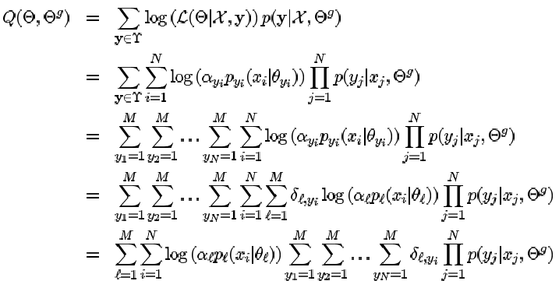
3.Finding Maximum Likelihood Mixture Densities Parameters via EM(Cont.)
Y_{i}=l

Slide 21
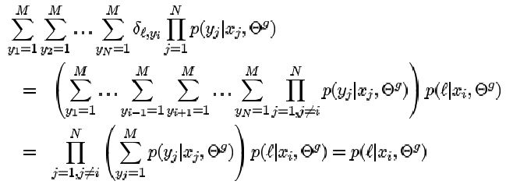
3.Finding Maximum Likelihood Mixture Densities Parameters via EM(Cont.)

Slide 22

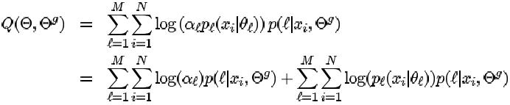
3.Finding Maximum Likelihood Mixture Densities Parameters via EM(Cont.)
term1
term2
We want to maximize Q(Ө,Ө^{(g)}),we can maximize the two term individually since they are not related.

Slide 23



3.Finding Maximum Likelihood Mixture Densities Parameters via EM(Cont.)
Now,we introduce the Lagrange multiplier λ with constraint

Slide 24

3.Finding Maximum Likelihood Mixture Densities Parameters via EM(Cont.)
Now,if we assume d-dimensional Gaussian component distributions with mean μ and covariance matrix Σ,i.e., Ө=(μ,σ²) then

Slide 25
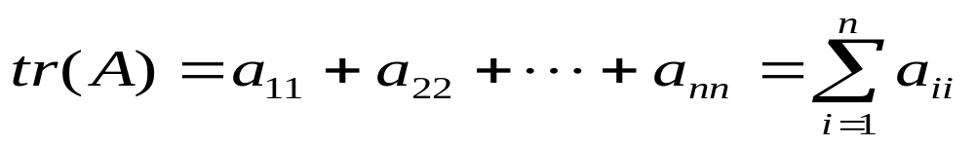
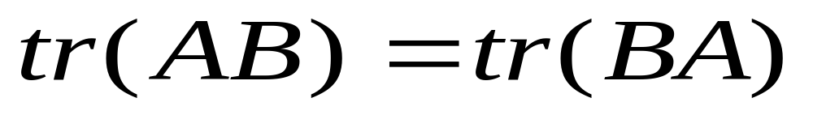
Fundamental Matrix

Slide 26
Fundamental Matrix(Cont.)
|A| = determinant of matrix A
A⁻¹ = the inverse matrix of A
|A| = |A⁻¹|

Slide 27
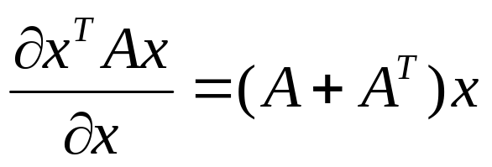
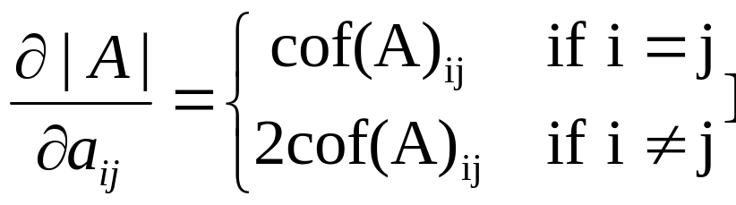
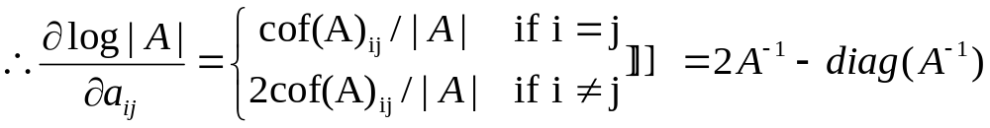
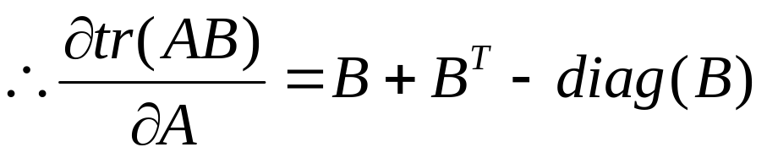
3.Finding Maximum Likelihood Mixture Densities Parameters via EM(Cont.)
First:
Second:
If A is symmetric

Slide 28
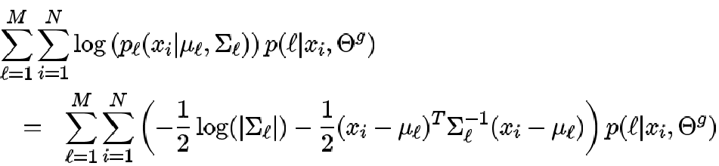

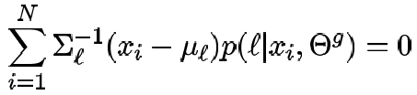
3.Finding Maximum Likelihood Mixture Densities Parameters via EM(Cont.)
Take the derivative with respect to and setting it equal to zero

Slide 29
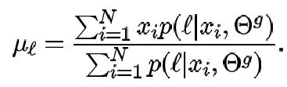
3.Finding Maximum Likelihood Mixture Densities Parameters via EM(Cont.)
Take the derivative with respect to and setting it equal to zero

Slide 30
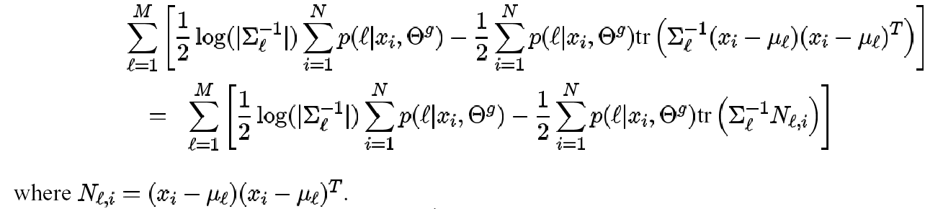

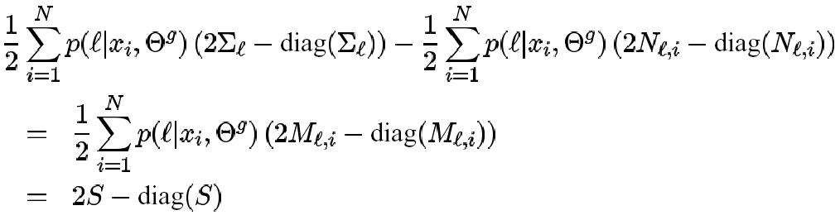
3.Finding Maximum Likelihood Mixture Densities Parameters via EM(Cont.)
Take the derivative with respect to

Slide 31
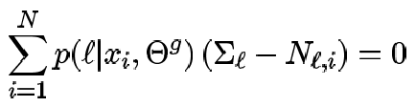
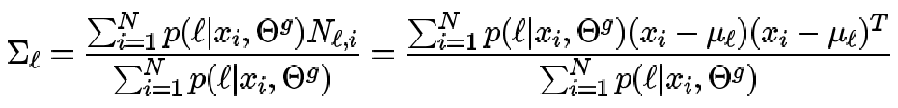
3.Finding Maximum Likelihood Mixture Densities Parameters via EM(Cont.)
Setting it equal to zero

Slide 32
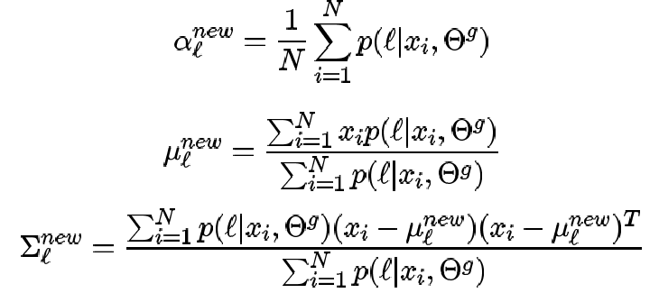
3.Finding Maximum Likelihood Mixture Densities Parameters via EM(Cont.)
Summarizing,the estimates of the new parameters in terms of the old parameters are as followss:

